Slide 1
TITLE: SALARY DATA ANALYSIS – ADVANCED EXCEL PROJECT
NAME: M.SUDHARSANAN
TOOLS USED : EXCEL

Slide 2
INTRODUCTION :
This project focuses on analyzing a comprehensive retail sales dataset to gain business insights and improve decision-making using advanced Excel tools.
The dataset includes thousands of transactions across various sales channels, product types, and customer segments.
By applying features like Power Query, PivotTables, What-If Analysis, Goal Seek, Macros, and Power Pivot, the project aims to:
Identify trends and patterns in sales performance
Evaluate the impact of returns and discounts
Highlight top-performing products and channels
Build an interactive, automated sales dashboard

Slide 3
Data Description and Preparation
Dataset: ~10,000 rows (Order ID, Product, Customer, Date, Sales)
Cleaning Steps:
Removed duplicates & blanks
Formatted dates and currencies
Resolved outliers and ensured valid “Net Quantity” values
Applied data validation rules

Slide 4
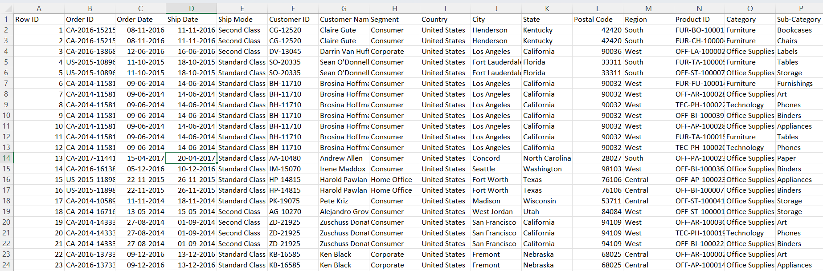
BEFORE CLEANING :

Slide 5
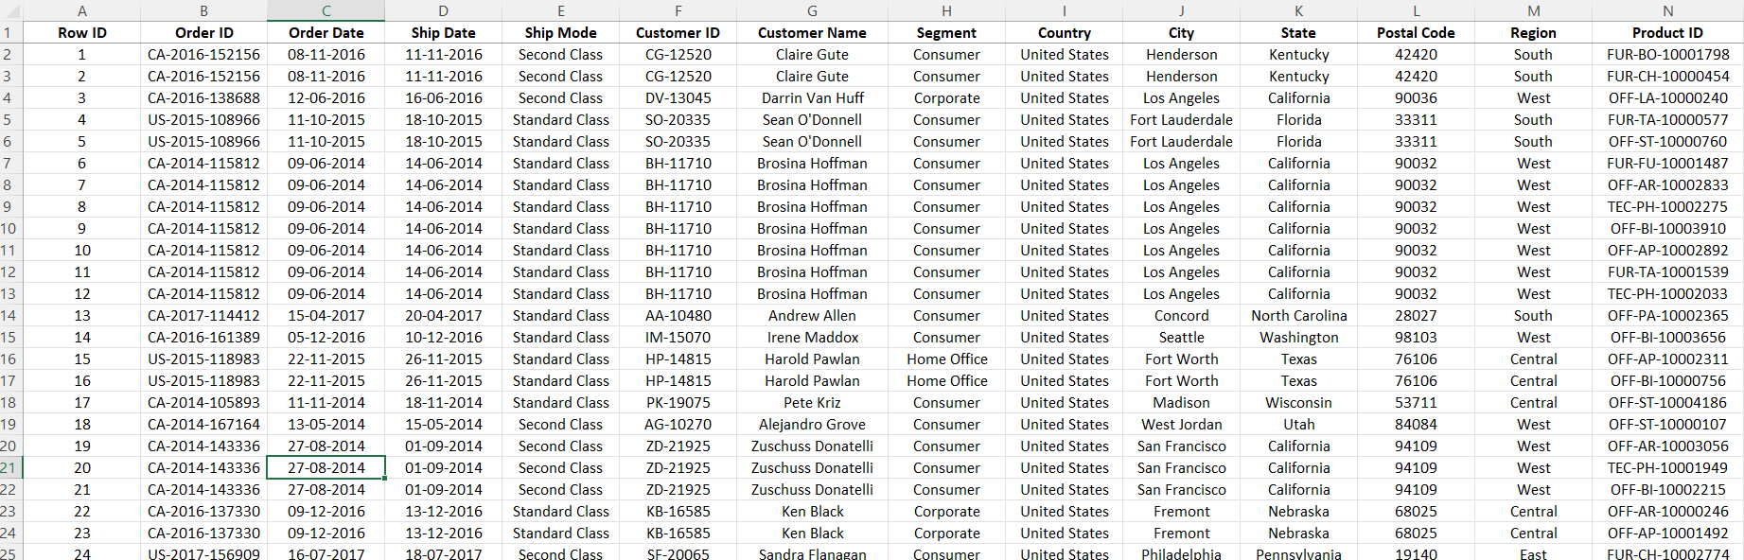
AFTER CLEANING :

Slide 6
Key Metrics & Calculations
Adjusted Sales = Gross Sales – (Discounts + Returns + Shipping + Taxes)
Metrics: Total Revenue, Avg Order Value, Discount %
Excel Functions: SUM, IF, IFERROR, AVERAGEIF, COUNTIFS

Slide 7
PivotTables & Charts
PivotTables: Analyzed Product Types, Channels, Regions, Time
PivotCharts: Visualized trends and performance

Slide 8
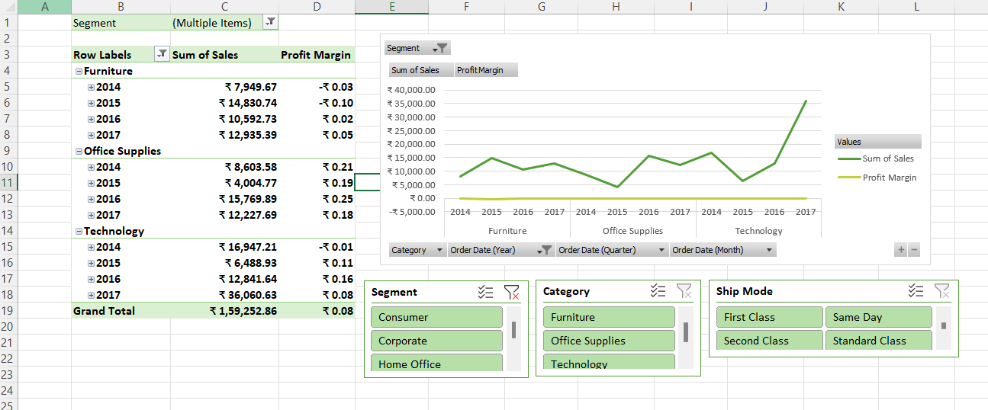
PIVOT TABLE :

Slide 9
Dashboard
KPIs: Total Sales, Adjusted Sales, Average Order Value, Total Returns, Profit Margin
Charts:
Line Chart: Monthly Sales Trend
Bar Charts: Sales by Region and Category
Pie Chart: Product-wise Sales Distribution
Interactivity:
Slicers for filtering by:
Date (Month/Year)
Product Category
Region
Sales Channel
Conditional formatting highlights negative profits
Automation:
Macros used to refresh data and visuals
Dashboard updates instantly with user input

Slide 10
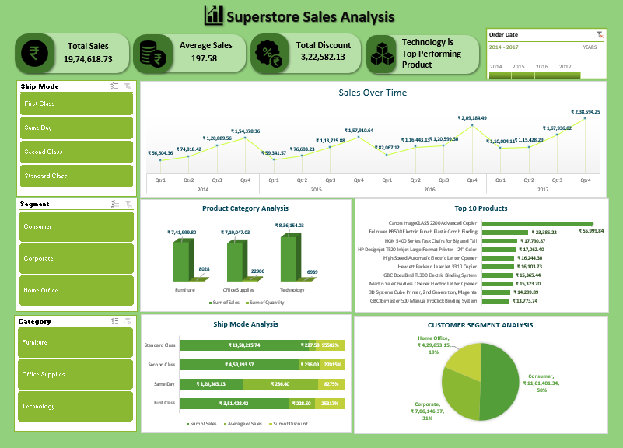
DASHBOARD :

Slide 11
What-If Analysis & Goal Seek :
What-If Analysis: Used Excel’s Scenario Manager and Data Tables to simulate business outcomes by adjusting key variables like price, return rate, and quantity sold.
Scenarios Tested:
10% increase in sales price → Revenue boost
5% decrease in return rate → Higher net sales
20% rise in quantity sold → Greater total revenue
Goal Seek: Applied Goal Seek to determine required values for reaching business targets.
Examples:
Units needed to hit ₹5,00,000 in Net Sales
Price needed to generate ₹1,00,000 profit

Slide 12
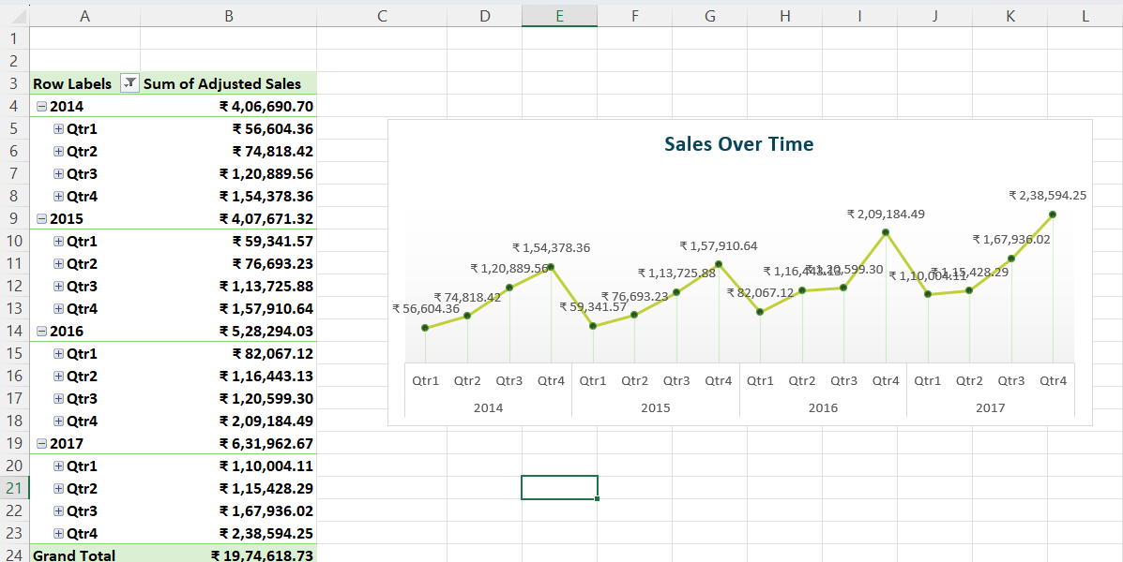
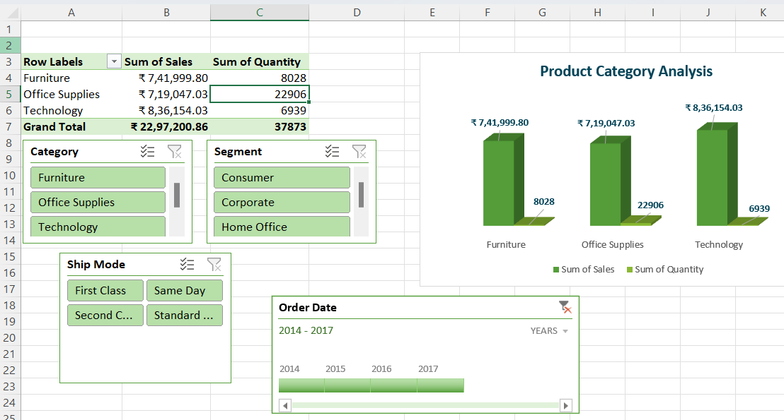
WHAT IF ANALYSIS AND GOAL SEEK :

Slide 13
Macros & Automation
Description:
Automated key tasks to enhance workflow and reporting speed.
Used VBA to streamline operations and add interactivity.
IMPLEMENTED MACROS :
1. Refresh All PivotTables
One-click refresh for all PivotTables across the workbook.
2. Generate Sales Trend Chart
Creates a monthly sales column chart from selected data automatically.
3. Export Dashboard to PDF
Instantly saves the Dashboard as a PDF report for sharing.
4. Insert Last Updated Timestamp
Displays a real-time update timestamp on the Dashboard sheet.

Slide 14
Insights & Recommendations :
Insights:
Top Channel: Online
Best Sellers: Phones, Chairs
Weak Area: Furniture returns
Recommendations:
Review discount policies
Promote top performers
Improve quality for high-return items

Slide 15
Conclusion :
Complete Excel-based analysis
Dynamic dashboard & automation
Clear, actionable insights

Slide 16
THANK YOU

